Slide 1

https://www.uni-goettingen.de/en/48115.html
UNPLAB-QuGen_Ch-4[MetrMod]
Model the Genotypic Value - to decompose and recompose it.
Wolfgang Link, University of Göttingen, Germany
1

Slide 2
Sequential Number: #38
UNPLAB-QuGen_Ch-4[MetrMod]
Unless I explicitly state otherwise, images and cartoons are created using ChatGPT.
You may use this material free of charge under the terms of the CC BY license. This requires that you provide appropriate attribution to the author:
W. Link, University of Goettingen, Germany.
In a few cases, individual images, photographs, or similar material may be subject to a more restrictive Creative Commons license. Where this applies, it is explicitly indicated, and you must comply with the stated license terms for those items.
Please check the license information carefully before reuse. Responsibility for complying with the applicable license terms rests entirely with you.
This symbol usually indicates that a page is rather important
2

Slide 3
You already know:
Keywords of this chapter:
Diversity vs. Variance; Normal Distribution and Variance; More than one trait to breed for; Qualitative vs. quantitative variation aka monogenic vs. polygenic variance; Impact of allele frequencies on variance, aka impact of selection of variance. You have seen the transition from monogenic to polygenic Segregation and Variance.
Algebra as introduced in this chapter:
Genotype | ‚True‘ genotypic value
AA | c + a
Aa | c + d
aa | c - a
L2: B|b | Locus1: A|a
 | AA | Aa | aa
BB | c+a₁+a₂+(aa)₁₂ | c+d₁+a₂ +(da)₁₂ | c-a₁+a₂-(aa)₁₂
Bb | c+d₂+a₁ +(ad)₁₂ | c+d₁+d₂+(dd)₁₂ | c+-a₁+d₂ -(ad)₁₂
bb | c+a₁-a₂-(aa)₁₂ | c+d₁-a₂ -(da)₁₂ | c-a₁-a₂+(aa)₁₂
3

Slide 4
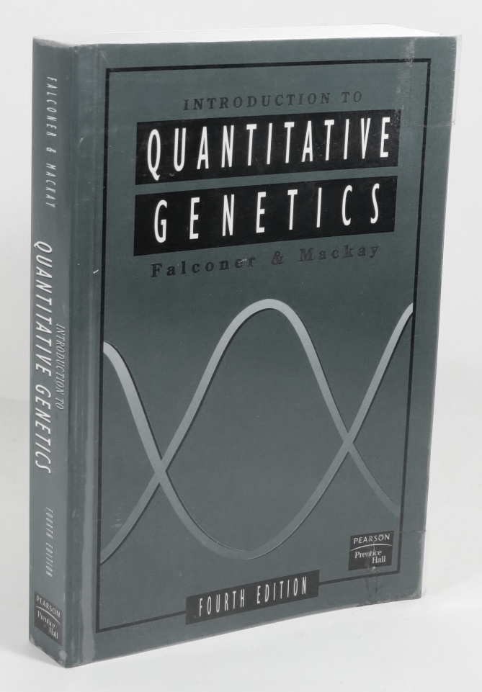
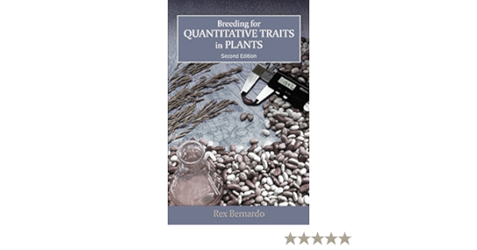
Two of several books from which you may study the Basics of Quantitative Genetics.
Two pertinent textbooks – there are further good ones available, of course, and
further texts that may help you to dive deeper into Basics of Quantitative Genetics.
DOI 10.1038/nrg3627 Trudy Mackay
DOI 10.2135/cropsci2007.04.0002IPBS Arnel R. Hallauer
DOI 10.1007/s10681-008-9723-4
SBN 978-1-78924-021-4
Selection implies breeding the next generation from the most superior individuals of this generation. Quantitative Genetics supports you when choosing superior candidates, to end up with the truly best ones (genetic value, genotypic value, breeding value); you learn to predict gain from selection in different settings and schemes, to compare; to increase efficiency of your work as breeder or researcher.
Falconer, D.S. and Mackay, T.F.C., 1996.
Introduction to Quantitative Genetics. 4th Edition, Addison Wesley Longman, Harlow.
Bernardo, R., 2020. Breeding for Quantitative Traits in Plants. Third Edition. University of Minnesota – Twin Cities. Stemma Press, Woodbury, Minnesota
ISBN 978-0-9720724-3-4
4

Slide 5
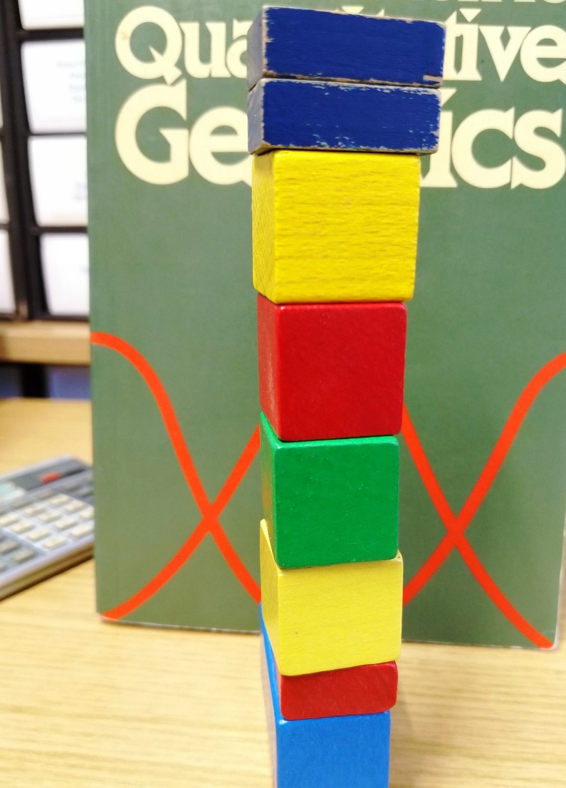
Models for the Genotypic value. Start with one locus.
5
We already focused on genetic or genotypic effects, G, (P=µ+G+E+GE), being the sum of many single loci’s effects; many loci that ‘jointly’ control the variation of trait expression – such as yield or fungus resistance. We consider first N=1 and then several or all loci ‘of’ a quantitative trait. So we decompose algebraically such G effects into the effects of the single genes. We shall study linear models which describe the combined action of genes. These models belong to two categories:
► Metric Model
► Statistical Model
We mostly assume that the genes at different loci act independently (no Epistasis) and that they are not correlated (LD is zero; no linkage; ‘free’ segregation). This implies that their effects (and contributions to the genetic variance) can be ‘naïvely’ added up across the loci to make a genotypic value or variance. With this, hence, it is valid to construct the models with only one of the pertinent loci, it being a valid example for all loci and a straight component of the sum-of-all loci.
© WL
It was a great break-through by R.A. Fisher in 1919 to think about the genetic foundation of traits such as plant height and grain yield ... as being controlled by the segregation at very many loci, each of which being one Mendelian factor just as the ones ‘for’ yellow or green and round or shrunken in the seeds of pea. This thinking reconciled the Mendelian findings with the empirical finding of the usually more-or-less continuous distributions of ‘quantitative traits’. ‘Infinitesimal Model’; DOI 10.1017/S0080456800012163

Slide 6
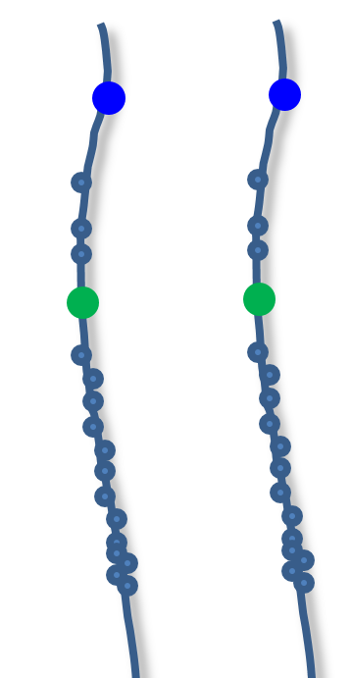
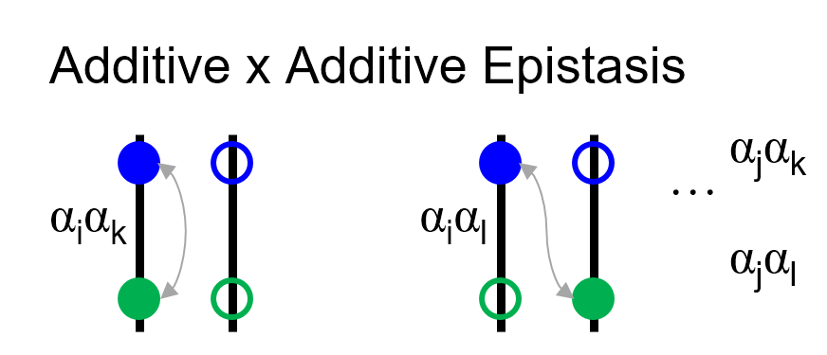
Models for the Genotypic value. Start with one locus, add up across loci later.
► Metric Model
► Statistical Model
Assuming no epistasis and zero LD implies that effects and variance caused by such segregating loci can be added up without considering covariance between them. Hence, it is valid to construct the models with only one of the pertinent loci, and then ‘easily’ and straightforward go to the sum-across-all-loci.
We can imagine LD=0. Yet, Epistasis exists! Interactions between genes at different loci (i.e. Epistasis) may involve 2 or more loci. Any generalization of 1-locus-models to these situations requires additional parameters. Nevertheless, if at all, then we restrict ourselves to 2-loci-interactions (di-genic Epistasis). The principles are well elucidated with this simplest case ;-)
LD between loci is neglected here, because the models would else become too cumbersome and because only for a small part of pairs of loci linkage* is to be expected (this part being < 1/x, where x equals the number of chromosomes in the haploid genome; in reality, most chromosomes yet break into at least two parts during meiosis, so the share of loci pairs that might show linkage is rather <1/2x).
see
later
DOI: 10.1038/nrg1407; BioEssays 27:637–646, 2005
*Visit UNPLAB-QuGen_Ch-2[Transition I] last page
6

Slide 7
Models for the Genotypic Value. Quantify the impact of a heterozygous locus compared to the homozygous loci (the one or the other allele). Allow for ‚some‘ dominance.
Indeed: a is the metric additive effect, and a is one of the two alleles.
This locus and its two alleles ‘A’ and ‘a’ may have an impact on the trait, be it monogenic such as presence-absence of an antitutritive compound, be it a trait such as oil or protein concentration in seed etc. We deal with ‚true‘ genetic values, no error, no mistake. The anchor point is the average of the trait-effect of ‚aa‘ and of ‚AA‘, written as ‚c‘. Take plant height of ‚AA‘ = 1.4m and for ‚aa‘= 0.6m. Then the Metric Additive Effect a is 0.4m, since ...
AA deviates from c=1.0m by plus 0.4m and
aa deviates from c=1.0m by minus 0.4m.
The Metric Dominance Effect d is the deviation of the impact of the heterozygous type ‚Aa‘ from c. Take it as plus 0.3m; d=0.3m. Again: d is the de-viation of Aa (say: 1.3m tall) from the two homo-zygotes‘ mean (c=1.0m).
We can express a ‚degree of dominance‘ as d/a.
Metric model of the Genotypic Value
c + a
c + d
a = Metric Additive Effect
d = Metric Dominance Effect
c
a = Metric Additive Effect
a
c - a
0
aa
Aa
AA
7

Slide 8
The Metric model for the Genotypic value. DOI: 10.1534/genetics.104.035857
8
The metric additive effect of a locus is defined with two alleles in mind that either cooperate in phenotype-‘making‘ in a recessive-dominant fashion or in intermediate way. We call this ‘Gene action’. Gene action (Genwirkungsweise) is thus either intermediate, partially dominant-recessive, fully dominant-recessive, or even over-dominant (if Aa is e.g. larger than AA). You could define under-dominance as well ;-)
The metric additive effect ‚a‘ and the metric domi-nance effect ‚d‘ do not care about allele frequency. If the allele ‚a‘ causes resistance in a recessive way, then we expect the genotype ‚aa‘ to be resistant, whether the allele ‚a‘ is frequent in your breeding population or rare.
Nota bene: For the reference value ‚c‘, we need not know the value of Aa.
► ► ► ‘c’ refers to the two homozygotes only.
Metric model of the Genotypic Value
c + a
c + d
a = Metric Additive Effect
d = Metric Dominance Effect
c
a = Metric Additive Effect
a
c - a
0
aa
Aa
AA

Slide 9
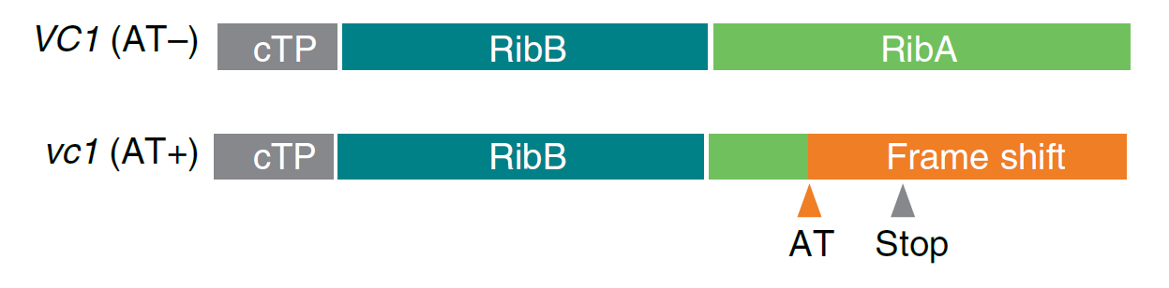
Models for the Genotypic value. Gene action (Genwirkungsweise) of the ‚wild‘-type RibA allele and the mutant-type RibA allele on the Vicine/Convicine % in V. faba seeds.
See UNPLAB-QuGen:Ch-3[Transition II] at page 5.
Vicine convicine, an antinutritive seed compound.
Total VC in % seed dry matter
Metric model of the genotypic value
V+C
c + a
0.50%
a=0.24%
c + d
0.30%
DOI: 10.1038/s41477-021-00950-w
d=0.04%
c
0.26%
3,4-dihydroxy-2-butanone 4-phsophate synthase / GTP cyclohydrolase II. A side-function of this enzyme impacts the Vicine-Convicine metabolism.
DOI 10.1038/s41477-021-00950-w
c.f. Tacke, PhD thesis 2023, Göttingen
The seed content of heterozygous VC1/vc1 types is near to the average of the two homozygous types (0.30% is only slightly > than 0.26%, hence the dominance effect d is rather small).
a
c - a
0.02%
0
aa
Aa
AA
9

Slide 10
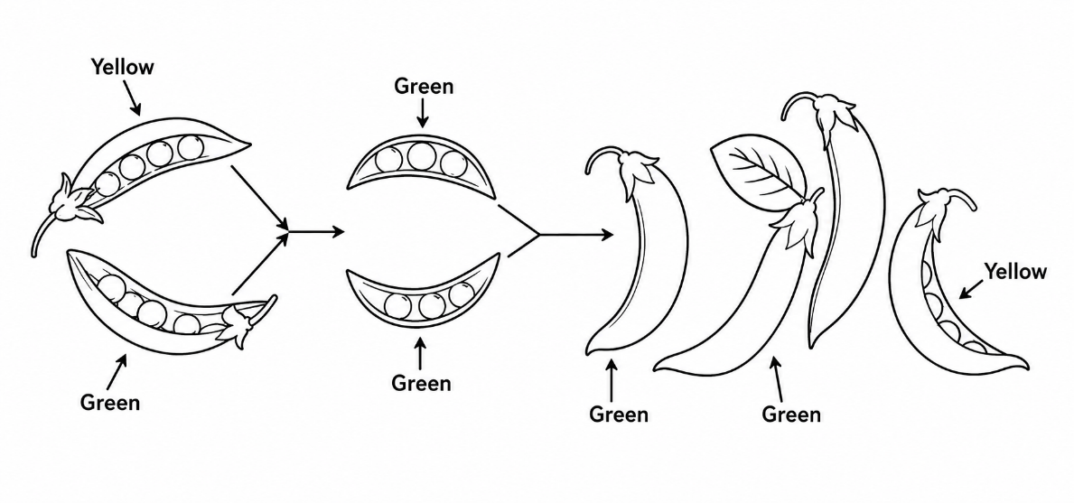
Rehearsal. We refer to c = mean of homozygotes. We use the so-called F∞-model.
With an alternative approach, the ‘F₂-model’, c= mean of the F₂-generation (‘1:2:1’).
“F∞-model” because it takes N=∞ gens. of selfing to come to full homozygosity; we do refer to homozygotes here.
Rehearsal. The parameters of the Metric Model describe the differences between the genotypic value of genotypes, independently from the gene- and genotype frequencies of the populations. They characterize gene action; e.g. the degree of dominance or type and size of epistatic effects among genes.
General assumption: 2 alleles per locus.
Interpretation of the parameters:
c = (AA + aa)/2 Mean of the tow homozygotes
a = (AA – aa)/2 Half the difference between homozygotes
d = Aa–(AA + aa)/2 Deviation of the heteroz. from the mean of the homoz.
AA, Aa & aa specify genotypic values: instead of writing G_{AA}, G_{Aa} and G_{aa}; (watch out, here we use AA etc. for both, genotype and genotypic value).
Google-Doodle from July 20, 2011 (Gregor Mendel‘s 189th birthday). Picture is wrong: Yellow is dominant over Green. And segregation is bet-ween seeds inside pods and not bet-ween pods. Well, Google is not responsive for classical Genetics.
If you gave figures for the colours, such as yellow=100 and green=0, then a = 50 and d = 50.
Yellow
Green
Genotype | ‚True‘ genotypic value
AA | c + a
Aa | c + d
aa | c - a
Have a look there ...
since they don’t allow ©
https://doodles.google/doodle/gregor-mendels-189th-birthday/
10

Slide 11
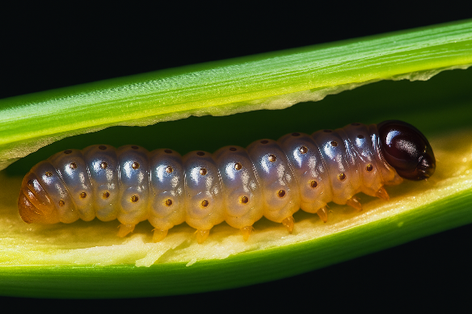
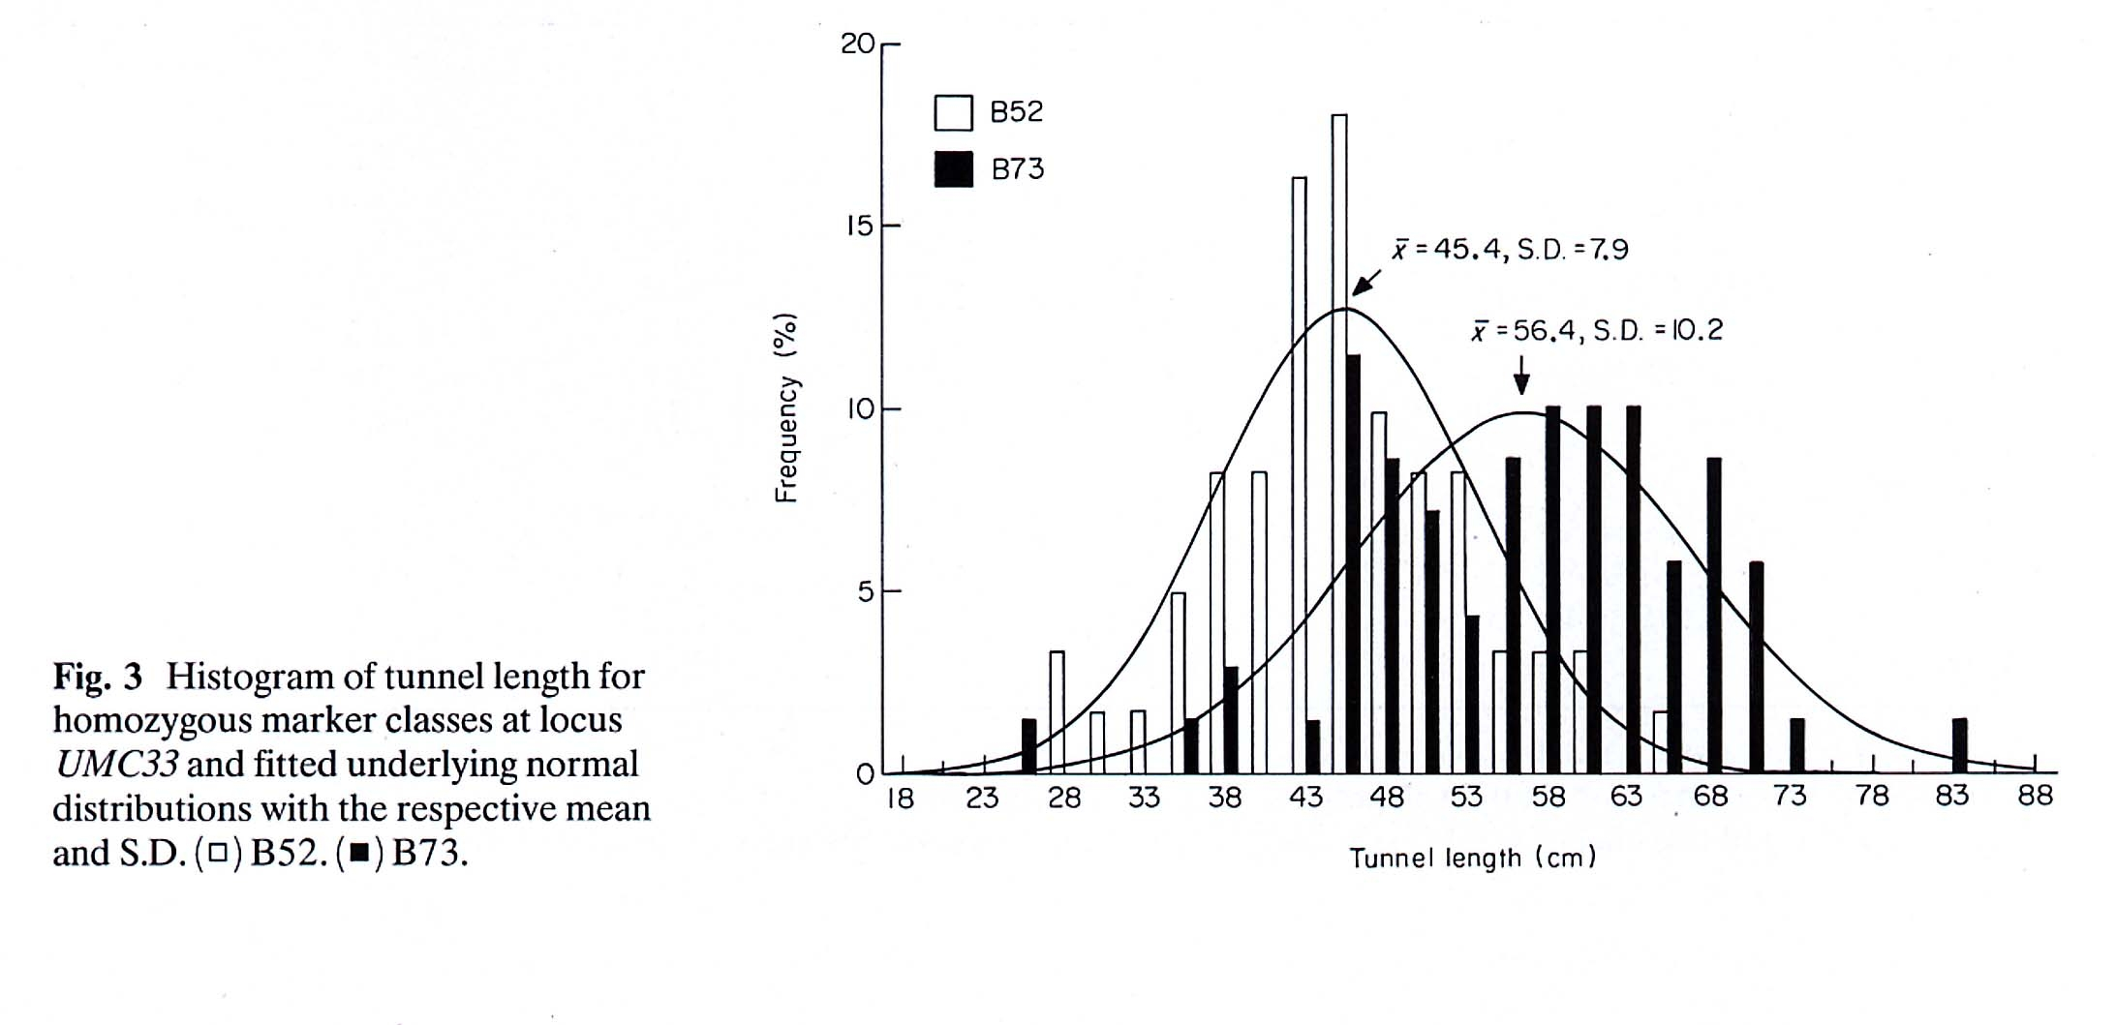
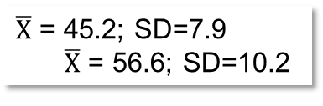
Metric additive effect of the two alleles ‘at’ locus UMC22 (associated with tunnel length caused by of European corn borer in maize). Average tunnel lengths of the two homo-zygous UMC33 types: 45.2cm and 56.6cm
The F2-individuals of this cross B52 x B73 were grouped according to whether they showed the B52 or the B73 homozy-gous allele at marker locus UMC33. The signi-ficant group mean diffe-rence indicated that this locus is associated with a gene ‚for‘ resistance. The additive effect was esti-mated as a=5.7cm: half the difference between the homozygotes.
The variation within the two classes is caused by further genes and by error variation.
-a
+a
‘A₁A₁’-genotypes
‘A₂A₂’-genotypes
Histogram shows tunnel (eating traces) length for the two homozygous DNA-marker classes at locus UMC33. DNA-data was from 300 F2-individuals. Pheno-type data was from their 300 resistance-tested F3-lines.
$\overline{X}$ = 45.2; SD=7.9
$\overline{X}$ = 56.6; SD=10.2
Frequency %
Schön, C.C. et al., 1993.
Heredity 70, 648-659
Tunnel length (eating traces) cm
High ....................resistance......................Low
11

Slide 12
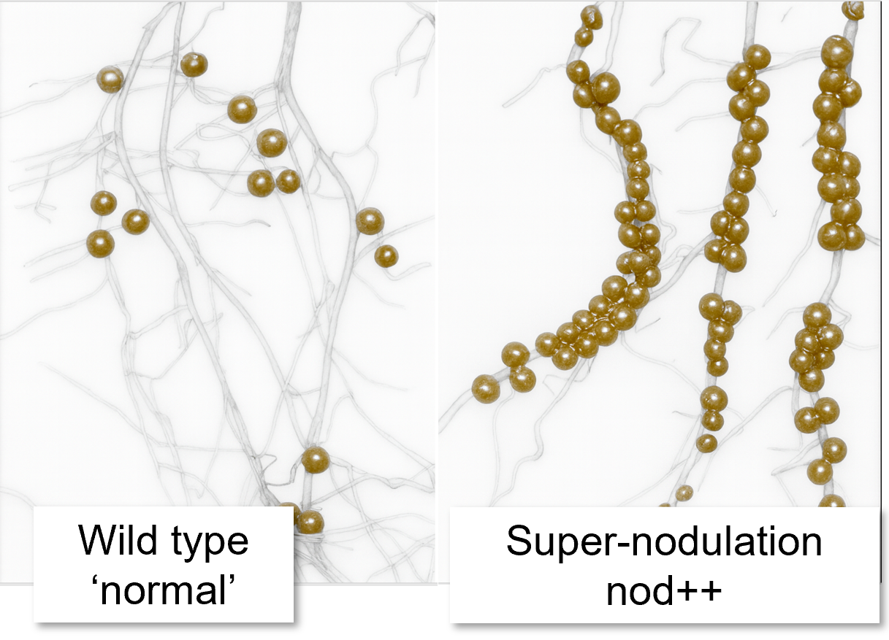
An example for Epistasis. Trait: Nodulation of specific soybean genotypes.
There is interaction between two loci „A|a“ and locus „B|b“
Soybean genotype “Bragg” and mutants of it. Parent 1: aa/BB (“a” ► non-nodul.; locus “nts382”) Parent 2: AA/bb (“b” ► super-nod.; locus “nod772”)
Number of nodules per plant (+/- standard error) depend on genotypes at these two loci. ‘Normal’ = ‘wild-type’: 150 nodules per plant
Locus B|b | Locus A|a
 | AA | Aa | aa
BB | 150 (10) | 150 (10) | 0
Bb | 150 (10) | 150 (10) | 0
bb | 370 (90) | 220 (20) | 20
Genotype „bb“ causes full development of all initiated nodules, whereas
genotype „BB“ reduces them to a normal number (150).
Contemplate on: What may be the metric effects ‚a‘ and ‚d‘ of the first and second locus?
DOI 10.1007/BF00223798; DOI: 10.1038/nrg1407; BioEssays 27:637–646, 2005
12

Slide 13
An example for Epistasis. Trait: Nodulation of specific soybean genotypes.
There is interaction between two loci „A|a“ and locus „B|b“
Soybean genotype “Bragg” and mutants of it. Parent 1: aa/BB (“a” ► non-nodul.; locus “nts382”) Parent 2: AA/bb (“b” ► super-nod.; locus “nod772”)
Number of nodules per plant (+/- standard error) depend on genotypes at these two loci. ‘Normal’ = ‘wild-type’: 150 nodules per plant
Locus B|b | Locus A|a
 | AA | Aa | aa
BB | 150 (10) | 150 (10) | 0
Bb | 150 (10) | 150 (10) | 0
bb | 370 (90) | 220 (20) | 20
Allele „a“ recessive to „A“; „b“ recessive to „B“. Genotype „aa“ (non-nod) epistatic over „B“ and over „b“ (super-nod): non-nod supresses super-nod. Impact of “Aa” < than of “AA” (220<370), since „A“ is not fully dominant over „a“.
Genotypes „bb“ causes full development of all initiated nodules, whereas „BB“ reduces them to a normal number (~150). Since 220<370, this only partial dominant action of „A“ over „a“ is hidden when we have „BB“ or “Bb”.
So, here, gene action of „A“ versus „a“ depends on which alleles occupy locus B. And see: aa/bb is not zero but 20.
Contemplate on: What may be the metric effects ‚a‘ and ‚d‘ of the first and second locus.
DOI 10.1007/BF00223798; DOI: 10.1038/nrg1407; BioEssays 27:637–646, 2005
13

Slide 14
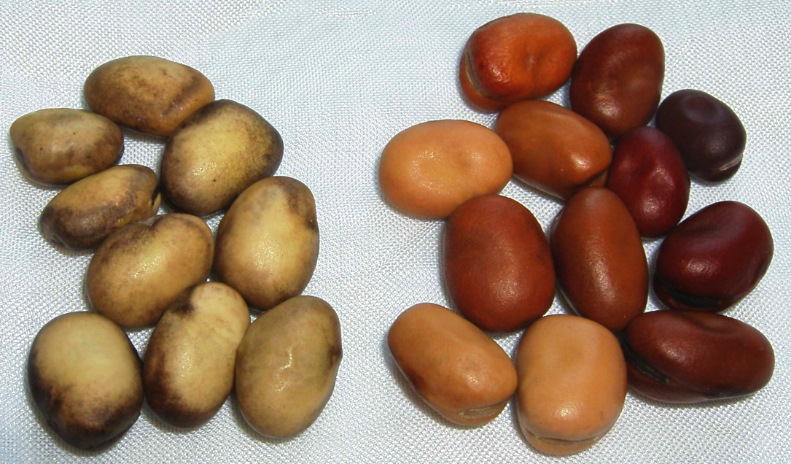
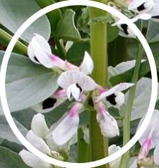
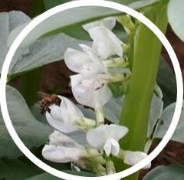
Still on Epistasis: Zero tannin in seed testa (Vicia faba)
© WLINK
Zero-tannin seed coat. Pleiotropically connected with total-white flower colour.
Tannin-containing wild-type seed. Seed testa colour is buff, brown; darkens by time. Flower shows colour.
14
14

Slide 15
The Quantitative Genetics Epistasis concept is more based on Algebra than on Biology.
Zero tannin
Normal type
Content of condensed tannins in dry matter as depending on genotype; and one expected value
Genotype | ZT₁ / ZT₁ | ZT₁ / tz₁ | zt₁ / zt₁
ZT₂ / ZT₂ | 1.00% | 1.00% | 0.01%
ZT₂ / zt₂ | 1.00% | 1.00% | 0.01%
zt₂ / zt₂ | 0.01% | 0.01% | - 0.98% ?!
Is zt1/zt1 .. zt2/zt2 lethal (as speculated in Plant Varieties and Seeds 13, 131-139)? ZT1 = transcription factor
TTG1; ZT2 = trans-parent-testa8 gene. DOI 10.1038/s41598-020-71070-2.
15

Slide 16
The Quantitative Genetics epistasis concept is more based on Algebra than on Biology.
Zero tannin
Normal type
Two loci in faba bean can cause zero tannin: ZT1|zt1 locus on chromosome II; ZT2|zt2 locus on chromosome III. The reces-sive alleles cause zero contents, respectively. Wild type has ~1% of condensed tannins, zero type ~ 0.01% in seed DM. [ZT1/ZT1] ..[zt2/zt2] … ~zero tannin
[zt1/zt1] ..[ZT2/ZT2] … ~zero tannin. But:
[ZT1/zt1] .. [ZT2/zt2] ... shows the normal, wild-type tannin content. ►As you cross these two zero-types, you get a normal, high-content type.
What a surprise (surprise ≡ Epistasis).
Biology says: No surprise. If [ZT1/zt1]_[ZT2/zt2] = double-heterozygous, neither the loss-of-function of zt1 nor of zt2 applies, tannin synthesis works, wild type occurs.
Quantitative Genetics: zt1/zt1 reduces content by ~ 1%. zt2/zt2 reduces by ~1%. Hence, jointly ;-) the type zt1/zt1 .. zt2/zt2 should be reduced by 2%. This means -1% tannin, a negative value. A biological nonsense. The deviation from the nonsense is here the „Epistatic effect“.
Content of condensed tannins in dry matter as depending on genotype; and one expected value
Genotype | ZT₁ / ZT₁ | ZT₁ / tz₁ | zt₁ / zt₁
ZT₂ / ZT₂ | 1.00% | 1.00% | 0.01%
ZT₂ / zt₂ | 1.00% | 1.00% | 0.01%
zt₂ / zt₂ | 0.01% | 0.01% | - 0.98% ?!
Is zt1/zt1 .. zt2/zt2 lethal (as speculated in Plant Varieties and Seeds 13, 131-139)? ZT1 = transcription factor
TTG1; ZT2 = trans-parent-testa8 gene. DOI 10.1038/s41598-020-71070-2.
16

Slide 17
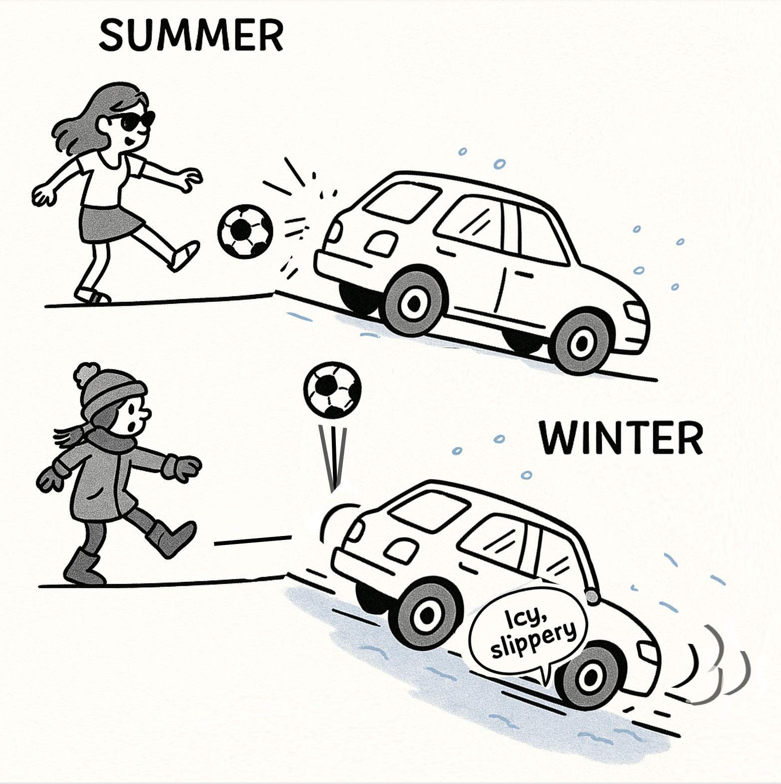
Interaction is if „it“ depends.
Interaction reveals itself through the element of surprise.
Twice same ‚action‘: A soccer ball hits a car.
Outcome depends.
● Summer, dry road surface: Nothing. ● Winter, as the car is already preca-riously parked on the icy surface, the ball’s impact is enough to send the car downhill (until, say, to the next tree to stop it).
No ball vs. a ball hitting. Outcome !?
Good vs. low tractation. Outcome !?
The impact of the one depends on the status of the other.
That is what INTERACTION is!
17

Slide 18
Interaction between ‚Sources of Variation‘. One concept, used again and again.
Dominant-recessive gene (inter-)action between the two allelic versions of a gene
Alleles ▼► | A | a
A | 20 | 20
Δ | 0 ≠ 6
a | 20 | 14
Epistatic interaction between two homozygous loci
Loci ▼► | BB | bb
AA | 20 | 20
Δ | 0 ≠ 6
aa | 20 | 14
Interaction between genotype and environmental impact on the phenotypic value
S. of Var. ▼► | Environm. 1 | Environm. 2
Genotype 1 | 20 | 20
Δ | 0 ≠ 6
Genotype 2 | 20 | 14
For G and E, you have already earlier seen this. Their joint impact can as well be formalized as G main effect and E main effect and then some ‚space‘ left for expected ;-) surprises (aka the GxE interactions).
18

Slide 19
Interaction between ‚Sources of Variation‘. One concept, used again and again.
Dominant-recessive gene (inter-)action between the two allelic versions of a gene
Alleles ▼► | A | a
A | 20 | 20
Δ | 0 ≠ 6
a | 20 | 14
Epistatic interaction between two homozygous loci
Loci ▼► | BB | bb
AA | 20 | 20
Δ | 0 ≠ 6
aa | 20 | 14
Interaction between genotype and environmental impact on the phenotypic value
S. of Var. ▼► | Environm. 1 | Environm. 2
Genotype 1 | 20 | 20
Δ | 0 ≠ 6
Genotype 2 | 20 | 14
Even the simple case of a dominant-recessive ‚cooperation‘ between the two alleles of a gene, such as between the wild type and the recessive mutant type of a tannin-content locus, can be understood as ‚interaction‘: If the first gamete contributed the dominant allele, say ‚A‘, then it is irrelevant for the phenotype whether the second allele contributes again ‚A‘ or ‚a‘. But, if the first gamete contributed ‚a‘, then it depends. So, the contribution of the second gamete has or not-has an effect on the phenotype, depending on the first gamete‘s contribution. ‘Depending’ ≡ ‘Interaction’. This is why sometimes ‚intermediate‘ gene action is called ‚additive‘, what is no good idea. It creates confusion with additive co-operation of different loci, which is synonymous with ‘no epistasis’. Epistasis means non-additive cooperation between loci.
19
For G and E, you have already earlier seen this. Their joint impact can as well be formalized as G main effect and E main effect and then some ‚space‘ left for expected ;-) surprises (aka the GxE interactions).

Slide 20
The Metric Additive Effect in case of non-zero Epistasis
follows
20

Slide 21
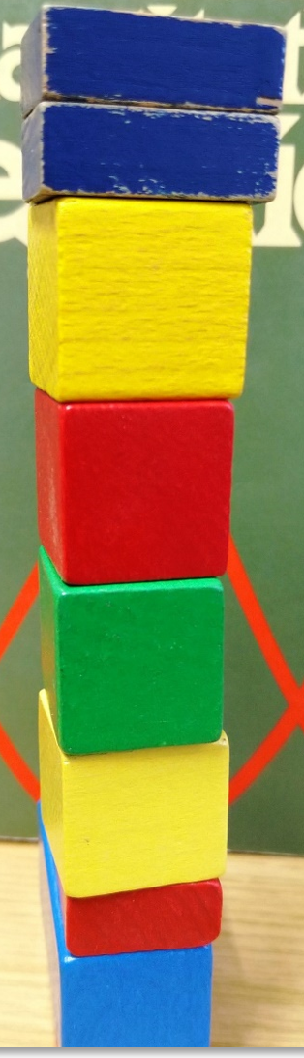
The metric additive effect in case of non-zero epistasis
21

Slide 22
Example for Epistasis. Interaction between locus 1 „A|a“ and locus 2 „B|b“.
Can we quantify the ‘amount’ of epistasis?
Number of nodules per plant. ‘Normal’ = ‘wild-type’: 150 |  |  |  | Number of nodules per plant given the additive effects as estimated yet zero Epistasis
L2: B/b | Locus1: A/a |  |  | Locus 1: A/a
 | AA | Aa | aa | AA | Aa | aa
BB | 150 | 150 | 0 | 200 | ? | -50
Bb | 150 | 150 | 0 | ? | ? | ?
bb | 370 | 220 | 20 | 320 | ? | 70
The metric additive effect of the A|a locus is, given BB: (150 – 0)/2 = 75 nodules per plant (and c=135).
The metric additive effect of the A|a locus is, given bb : (370 – 20)/2 = 175 nodules per plant).
Our ;-) compromise then is to say: The metric additive effect is the average, it is ‚a₁‘ = 125 nodules per plant.
With the same reasoning, the metric additive effect of B/b locus is then is ‚a₂‘ = -60 nodules per plant.
Applying this to predict (tinker) the values of the four fully homozygous genotypes, we get quite wrong results.
We predict, for instance, for the AA/BB genotype; c+a₁+a₂ = 200 .... ≠ 150; et cetera.
So: Not allowing Epistatic, this perspective ‚forces‘ …
the differences between e.g. AA/BB and AA/bb ► 200 - 320 = -120 to be the same as
the difference between aa/BB and aa/bb ► -50 - 70 = -120.
This is a simplification and deviation from the honestly more complex biological situation here.
All the homozygote-values here deviate from their ‚true‘ values by amounts of plus or minus 50.
c=135
Obviously, we have no parameters yet to estimate values for the 5 non-fully homozygous genotypes ... “?”.
22

Slide 23
Example for Epistasis. Interaction between locus 1 „A|a“ and locus 2 „B|b“.
Can we quantify the ‘amount’ of epistasis?
Number of nodules per plant. ‘Normal’ = ‘wild-type’: 150 |  |  |  | Number of nodules per plant given the additive effects as estimated yet zero Epistasis
L2: B|b | Locus1: A|a |  |  | Locus 1: A/a
 | AA | Aa | aa | AA | Aa | aa
BB | 150 | 150 | 0 | 200 |  | -50
Bb | 150 | 150 | 0
bb | 370 | 220 | 20 | 320 |  | 70
Look at the pattern of the marked ‘+’ and ‘-’ signs
L2: B|b | Locus1: A|a
 | AA | Aa | aa
BB | c+a₁+a₂+(aa)₁₂ | c+d₁+a₂ +(da)₁₂ | c-a₁+a₂-(aa)₁₂
Bb | c+d₂+a₁ +(ad)₁₂ | c+d₁+d₂+(dd)₁₂ | c+-a₁+d₂ -(ad)₁₂
bb | c+a₁-a₂-(aa)₁₂ | c+d₁-a₂ -(da)₁₂ | c-a₁-a₂+(aa)₁₂
Basic parameters of the F∞ model
c | Mean of all homozygotes
a₁ | Additive, locus 1 | (aa)₁₂ | Additive-add. epistatic
a₂ | Additive, locus 2 | (ad)₁₂ | Additive(L1)-dom.(L2)
d₁ | Dominant, loc. 1 | (da)₁₂ | Dominant(L1)-add.(L2)
d₂ | Dominant, loc. 2 | (dd)₁₂ | Dom.-dom. Epistatic
You see that this concept of Epistasis is pure Algebra and Statistics and is barely connected to Biology. Nevertheless: It allows to see from trait data of genotypes whether loci add up their impact on trait additively; or whether they interact (means: whether they show Epistasis).
23

Slide 24
Example for epistasis. Interaction between locus 1 „A|a“ and locus 2 „B|b“.
Can we quantify the ‘amount’ of epistasis?
Number of nodules per plant. ‘Normal’ = ‘wild-type’: 150 |  |  |  | Number of nodules per plant given the additive effects as estimated yet zero Epistasis
L2: B|b | Locus1: A|a |  |  | Locus 1: A/a
 | AA | Aa | aa | AA | Aa | aa
BB | 150 | 150 | 0 | 200 |  | -50
Bb | 150 | 150 | 0
bb | 370 | 220 | 20 | 320 |  | 70
See the G values composed from their model effects
L2: B|b | Locus1: A|a
 | AA | Aa | aa
BB | c+a₁+a₂+(aa)₁₂ | c+a₂+d₁ +(da)₁₂ | c-a₁+a₂-(aa)₁₂
Bb | c+a₁+d₂ +(ad)₁₂ | c+d₁+d₂+(dd)₁₂ | c+-a₁+d₂ -(ad)₁₂
bb | c+a₁-a₂-(aa)₁₂ | c-a₂+d₁ -(da)₁₂ | c-a₁-a₂+(aa)₁₂
See the G values composed from their model effects
L2: B|b | Locus1: A|a
 | AA | Aa | aa
BB | 135+125-60-50=150 | 135-60+50+25=150 | 135-125-60+50=0
Bb | 135+125-60-50=150 | 135+50-60+25=150 | 135-125-60+50=0
bb | 135+125+60+50=370 | 135+60+50-25=220 | 135-125+60-50=20
Study the next pages to see that this ‚real‘ example is near to what is called complementary gene action as a type of epistasis, yet, not exactly so (because the aa/bb genotype value is not zero here and because the AA/bb and Aa/bb differ, this is, in other words, because the full dominance of A over a is not true anymore in case of ../bb.
24

Slide 25
Composition of the genotypic values based on the Metric Effects, including digenic epistasis locus 1 „A|a“ and locus 2 „B|b“ (F∞ model); and Estimation of them …
25
No need to learn this by heart ;-)

Slide 26
Epistatic digenic interactions may be complementary, duplicate or more complex
Basic types of gene action, example data. Left: The genotypic values. Right: The corresponding parameter values
(F∞ metric), from which the G values can be re-composed
E.g.: G(AA/BB) = c+a₁+a₂+(aa)₁₂=12.5+2.5+2.5+2.5=20.0
26

Slide 27
Generalization and summation of digenic Epistatic interaction values to N = many loci
Loci | c + … |  | 1 | 2 | 3 | 4 | 5 | 6
 |  |  | AA | Bb | CC | dd | Ee | FF
1 | AA | a₁ | - | (ad)₁₂ | (aa)₁₃ | -(aa)₁₄ | (ad)₁₅ | (aa)₁₆
2 | Bb | d₂ |  | - | (da)₂₃ | -(da)₂₄ | (dd)₂₅ | (da)₂₆
3 | CC | a₃ |  |  | - | -(aa)₃₄ | (ad)₃₅ | (aa)₃₆
4 | dd | -a₄ |  |  |  | - | -(ad)₄₅ | -(aa)₄₆
5 | Ee | d₅ |  |  |  |  | - | -(da)₅₆
6 | FF | a₆ |  |  |  |  |  | -
The genotypic value of the visualized 6-loci genotype hence can be composed accordingly as G_{i(1-6)} = c + a₁ + d₂ + a₃ + -a₄ + d₅ + a₆ +
(ad)₁₂ + (aa)₁₃ -(aa)₁₄ + (ad)₁₅ + (aa)₁₆ + … -(da)₅₆.
Potential epistatic interactions between triplets and quartets etc. of loci are ignored. It may very well be that some or many of these parameters such as a₁ or (ad)₁₂ etc. are very small or zero. These parameters are rather like labelled boxes, the content of which has to be found by experiments. So, „-(aa)₁₄“ may e.g. contain a negative content, making its ultimate contribution positive; and so forth.
The sum of all here-occuring additive effects can be written as summation parameter a = a₁ + a₃ -a₄ + a₆; and so forth for all the types of parameters.
27

Slide 28
Generalization and summation of digenic epistatic interaction values to N = many loci
Loci | c + … |  | 1 | 2 | 3 | 4 | 5 | 6
 |  |  | AA | Bb | CC | dd | Ee | FF
1 | AA | a₁ | - | (ad)₁₂ | (aa)₁₃ | -(aa)₁₄ | (ad)₁₅ | (aa)₁₆
2 | Bb | d₂ |  | - | (da)₂₃ | -(da)₂₄ | (dd)₂₅ | (da)₂₆
3 | CC | a₃ |  |  | - | -(aa)₃₄ | (ad)₃₅ | (aa)₃₆
4 | dd | -a₄ |  |  |  | - | -(ad)₄₅ | -(aa)₄₆
5 | Ee | d₅ |  |  |  |  | - | -(da)₅₆
6 | FF | a₆ |  |  |  |  |  | -
The genotypic value of the visualized 6-loci genotype hence can be composed accordingly as G_{i(1-6)} = c + a₁ + d₂ + a₃ + -a₄ + d₅ + a₆ +
(ad)₁₂ + (aa)₁₃ -(aa)₁₄ + (ad)₁₅ + (aa)₁₆ + … -(da)₅₆.
Potential Epistatic interactions between triplets and quartets etc. of loci are ignored. It may very well be that some or many of these parameters such as a₁ or (ad)₁₂ etc. are very small or zero. These parameters are rather like labelled boxes, the content of which has to be found by experiments. So, „-(aa)₁₄“ may e.g. contain a negative content, making its ultimate contribution positive; and so forth.
The sum of all here-occurring additive effects can be written as summation parameter a = a₁ + a₃ -a₄ + a₆; and so forth for all the types of parameters.
28

Slide 29
From here you may go to UNPLAB-QuGen_Ch-5[GenMeanAnal]
© WL
The building blocks here are meant to convey a bit ironi-cally and mockingly, that in Quantitative Genetics, every-thing works somewhat like this: “One plus one equals two, and one more makes three.”
29

